Slide 1
Neopride Online Garment Store Concept Details

Slide 2





Workflow
NeoPride Operations
Neopride takes pictures and uploads in webportal with other details
Makes it visible for Retailer/Wholesalers in portal and App ( Both will be having different price & MOQ )
Brand Owner
Sends sample items, color\size variations, MOQ, Ratios to Neopride
NeoPride Delivery
Scans barcode , updates in the System as ”Delivery left from Godown”
Transports package to Delivery teams in customer colocations.
NeoPride
Operations
3
Neopride Operations(Godown )
Accepts delivery of garments against the orders placed
Packages the garments based on order id and delivery address, adds bar code
Updates the webportal
NeoPride Delivery
Retailer\Wholesaler
Registers with the Webportal & App
Places Order in Retailer \Wholesaler Portal.& App
Item, Qty, MOQ Schedule, Delivery Address
Tracks orders through webportal & App
Invoice should be generated Automatacilly .
NeoPride Delivery
NeoPride
Operations
NeoPride Operations
Views the list of orders pending from the retailers\wholesalers
Communicates order requirements to the manufacturers on the delivery timelines via SMS, mail etc??
NeoPride Delivery
Receives package, Scans barcode and updates the system “On route to delivery to customer”
Transports package to customer locations.
On delivery to customer, the customer scans bar code , updates system as ”delivery complete”
Ack from customer updated in system( code\sign etc.)

Slide 3
Attendance Management
Attendance( Staff, Marketing, Delivery)
Logs in the mobile App to start office hours
Updates reports on activities through mobile app
GPS application sends location of the staff(Office\Marketing\Delivery) on a frequent basis to the server along with the Login time and reports.
Neopride Admin
Logs in Attendance Admin Portal
Portal provides list of attendees on a per day basis and login and logout times
Through track location, Admin can get current location of the staff and also trail of travel by the staff who has logged in.
Server

Slide 4
Attendance Panel
Login once he reaches office
Update reports on a frequent basis( every one hour or on visit to the store)
Staff in corporate office
Marketing executives
Delivery team
GST details and Brand registration
Brand registration – There should be a web portal to get details on brand. The details should be sent to list of Neopride mail ids. This need to be made visible to the customers when items are added against these brands.

Slide 5
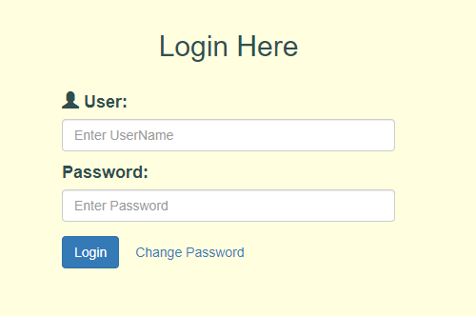
Retailers\Wholesalers –Login
Registration
Name
Address
Phone Number
Email
Wholesaler\Retailer
GST Mandatary
Login Credentials Creation
UserName /Password
OTP – validation through SMS

Slide 6

Retailers\Wholesalers
Dashboard
List of Active Orders with status (as booked, Progress, Being shiped, Delivered)
Option to Expand Order Details
Creation of New Order
Selection of Items
Selection of Date
Repeat orders –periodically
Payment Options
Cash /Card
Payment Gateway interface
Delivery Address & Time
Bill Generation
SMS Indication
Order confirmation
Delivery ACK Code for every Delivery Note
( An order could be delivered in multiple phases)

Slide 7
Neopride Operations
List of orders by Date, time, Location and any special instructions, Approval for orders to be delivered
Order Id, Date and time of delivery
Location
Order Contents
Availability in Inventory to meet order
Delivery Note Generation for Approved orders
Raise work tickets for packing team to pack orders giving order details and shipment address
Raise requests from manufactures for new orders
List of Purchase orders
Status of purchase orders( Order approved, delivery complete, In transit, etc.)
SMS /Mail
On creation of New PR, Delivery note, Work tickets

Slide 8
Neopride Operations(Godown)
Incoming Material
-List Of Requests to manufacturers display with Status(Pending)
-Accept Material Against Requests and close
Order requests and Packaging Status
-List of Retailer\Wholesaler order requests to be processed and status
- Updation of Package status(Packed\Packing in progress\Packaging not started)
Delivery
- Issue finished packs to Delivery boys based on DN.
- Provide delivery Details
Rejected Items
- Account Rejected items both incoming and returned products.
Report
- On stocks/Transactions/Rejections

Slide 9
Neopride Operations(Manufacturer Requests)
List of Manufacturer Requests
Items
Quantities
Option to update the Manufacturer Request status, forecasted availability time.
SMS /Mail
On creation of New MR
Alert on Order delivery ‘Not Met’ or ‘Not Going To Be Met’

Slide 10
Delivery
SMS/Mail
List of Delivery Notes Assigned
Deliver ACK
- Receives ACK CODE and Updates CODE

Slide 11

Packers
Work Tickets Displayed against Name
Packers collect material from Store Keeper
RF scanning of Employee Id
Packers return Finished Packs to Store
Rf Scanning of Employee Id and Packs
Report Created on Work efficiencies
Time Taken for Job ticket
Resource wise Reports

Slide 12
SW Infrastructure
Separate domain
Dedicated cloud instances for Neopride
Security infrastructure – https ( secured web pages)
Digital certificates support

Slide 13
THANK YOU

